Slide 1
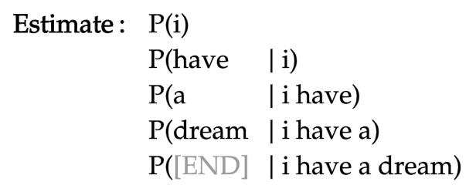

Slide 2
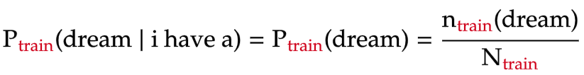
total number of words in training text

Slide 3
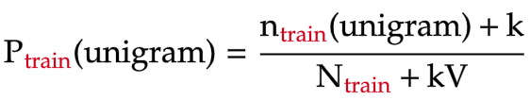
unigram vocabulary size
(number of unique unigrams in training text)

Slide 4
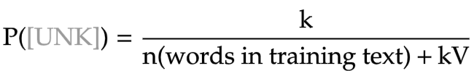

Slide 5
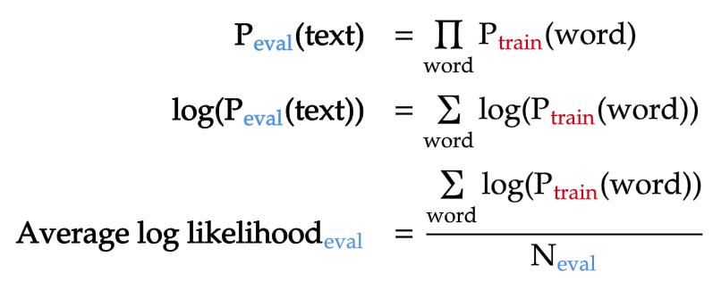
total number of words in evaluation text

Slide 6
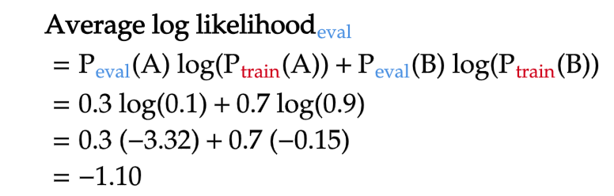

Similar unigram distributions between training and evaluation texts
Different unigram distributions between training and evaluation texts

Slide 7
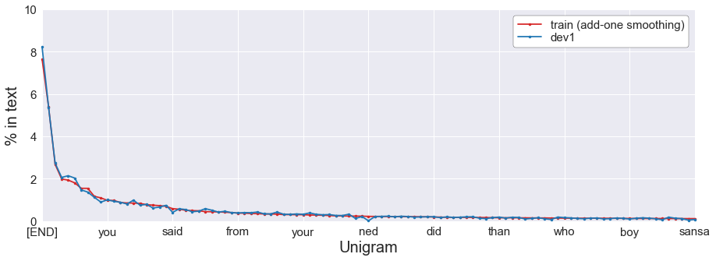


Slide 8
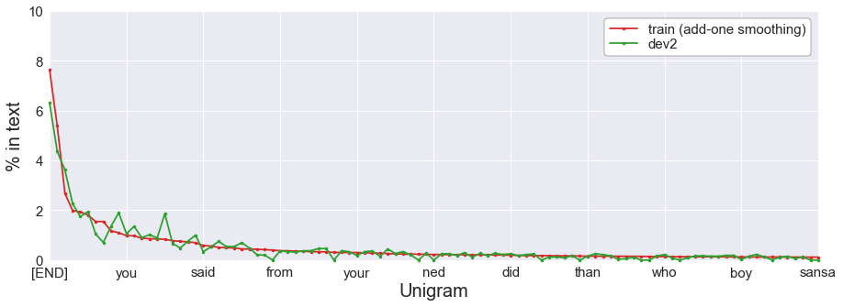

her
she
his

Slide 9
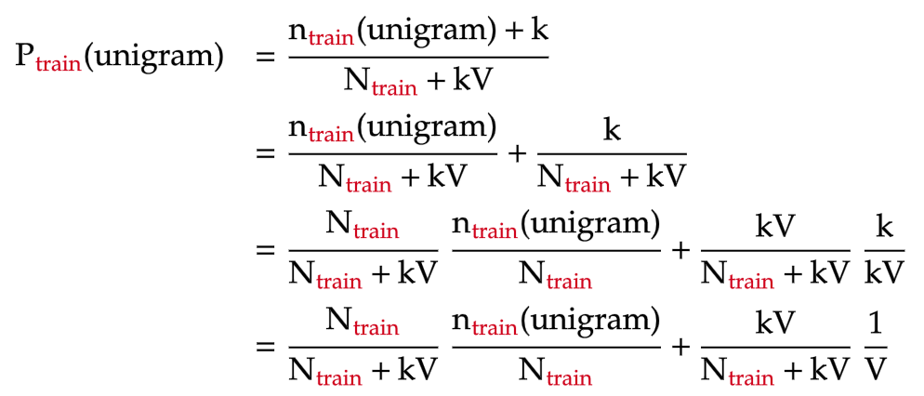
un-smoothed unigram probability
uniform probability

Slide 10
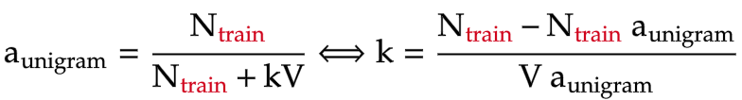
proportion of un-smoothed unigram model

Slide 11
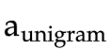
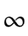
interpolation weight of un-smoothed unigram model
0
0.2 | 106
0.4 | 40
0.6 | 18
0.8 | 7
1 | 0

Slide 12
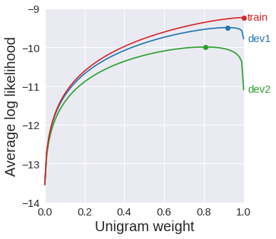
100%
uniform
100%
unigram
Overfit
Low bias
High variance
Underfit
High bias
Low variance

Slide 13



train
dev1
dev2

Slide 14
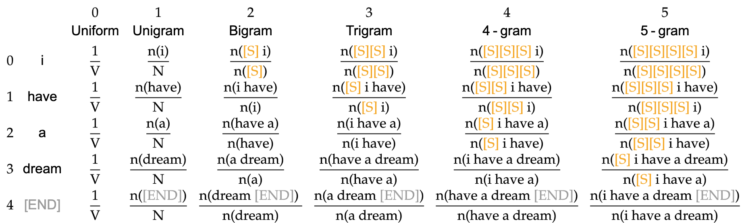

N-gram length
=
=
=
=
=
Token position in sentence
=
...

Slide 15
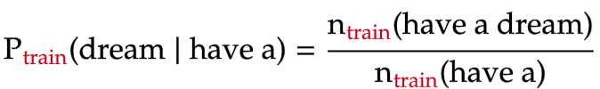

Slide 16
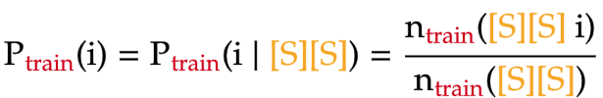
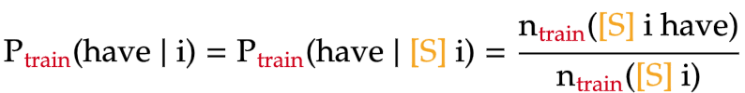

Slide 17
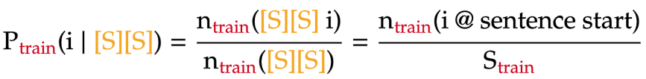

Slide 18
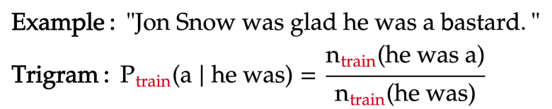

Slide 19
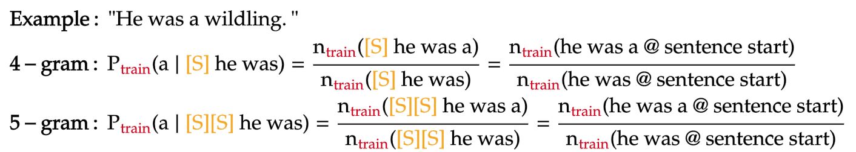

Slide 20
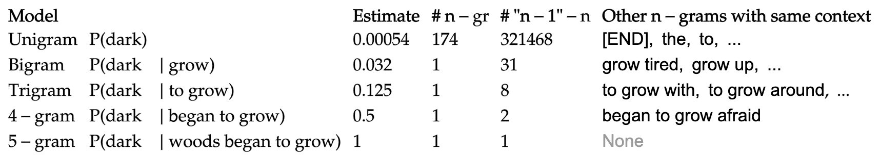
Model | Probability | Estimate | # n-gram | # (n-1)-gram | Other n-grams with same context

Slide 21
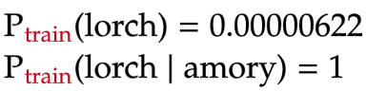


Slide 22
Model | Number of unknown n-grams | Percent of unknown n-grams
Unigram | 11500 | 3.2
Bigram | 108509 | 30.7
Trigram | 233681 | 66.2
4-gram | 284413 | 80.5
5-gram | 296048 | 83.8

Slide 23
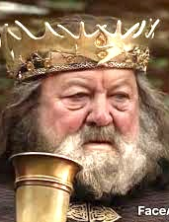
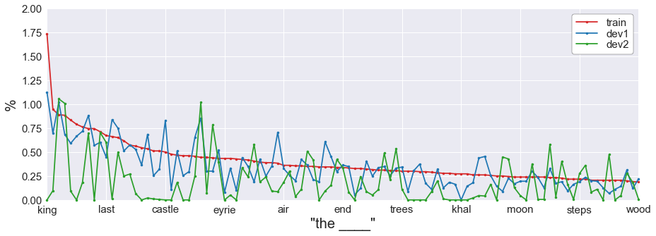

Slide 24
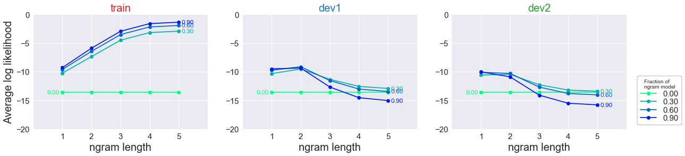

Slide 25
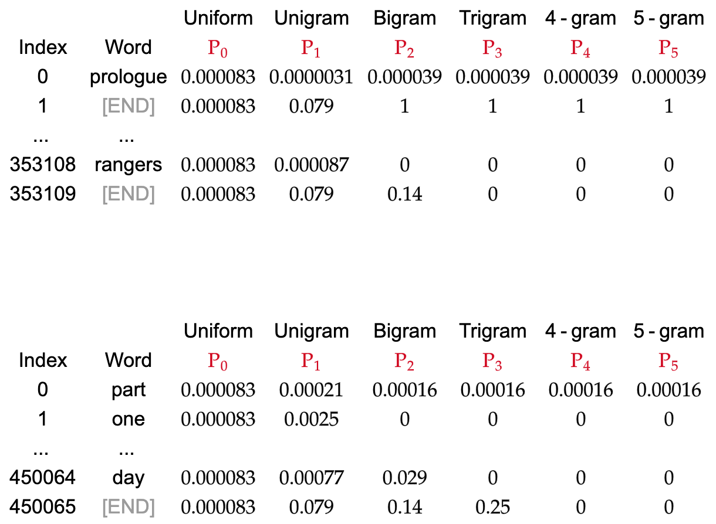
dev1
Models
dev2
dev1_prob_matrix
Models
dev2_prob_matrix

Slide 26
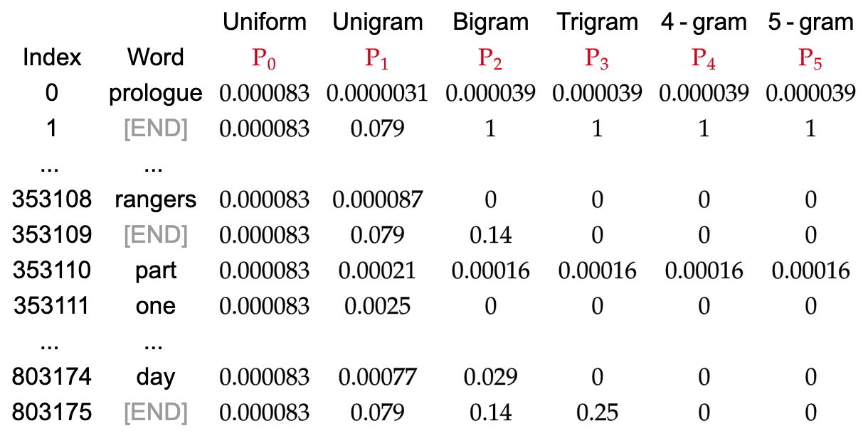
dev1
dev2
Models
dev_prob_matrix = np.vstack([dev1_prob_matrix, dev2_prob_matrix])

Slide 27
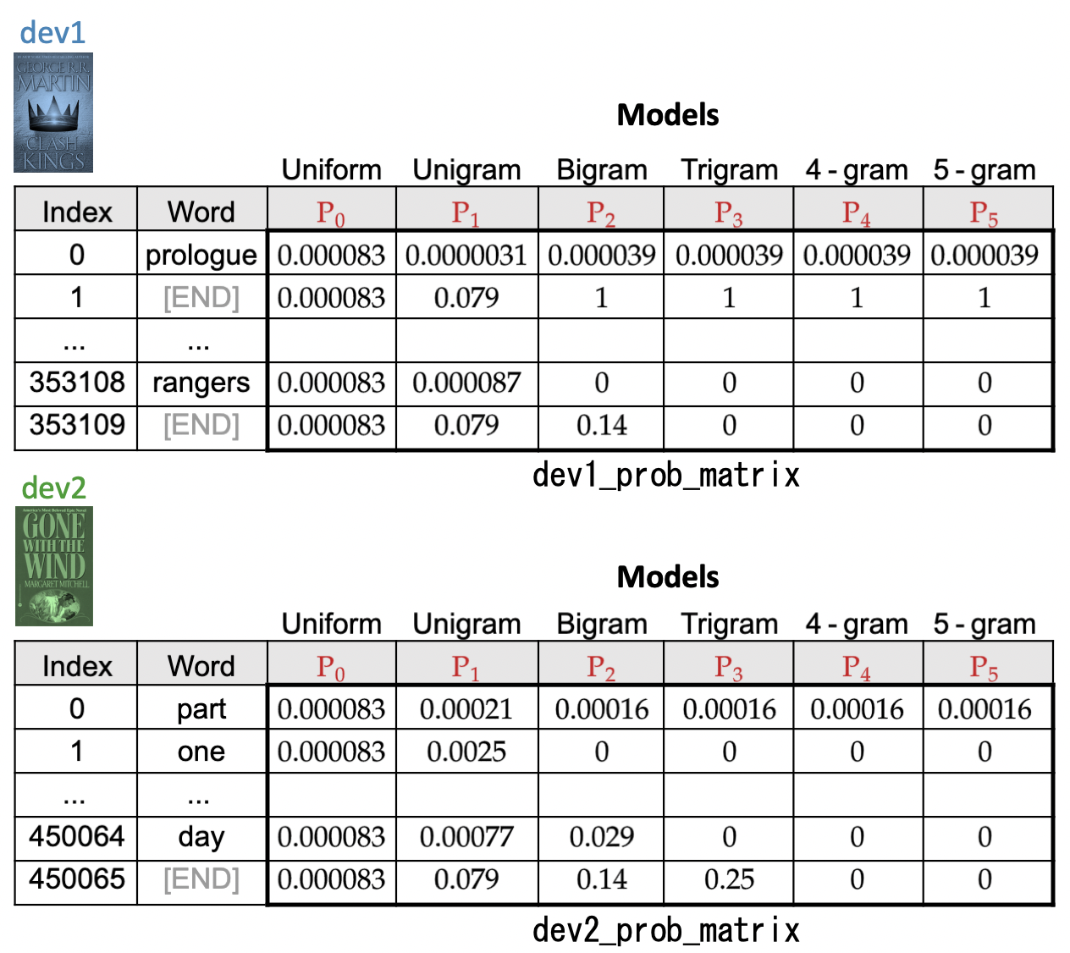
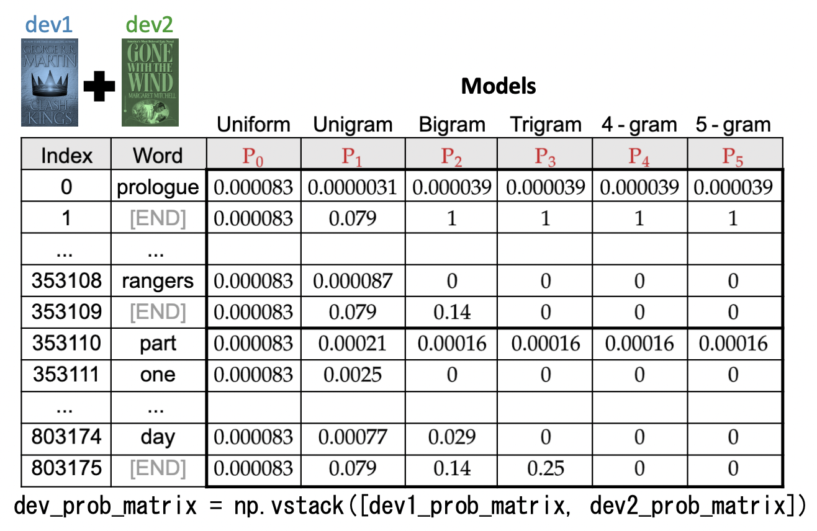

Slide 28
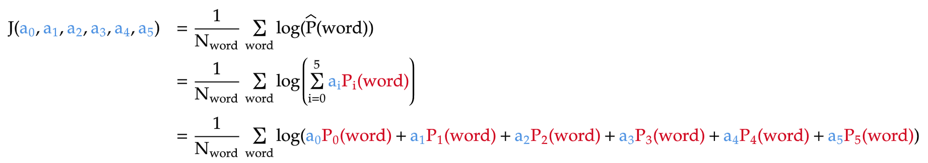
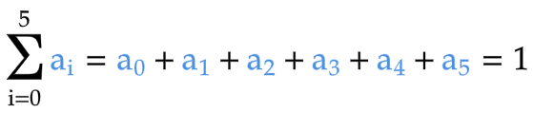
Objective function (to be maximized)
Constraint

Slide 29
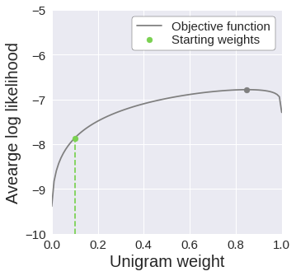
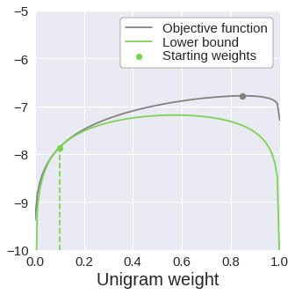
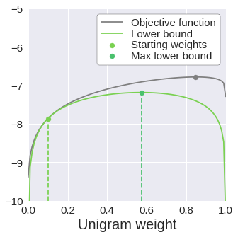
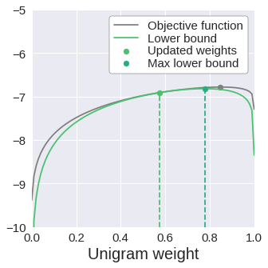
1
Initialize
2
E-step
3
M-step
4
Repeat
tight

Slide 30
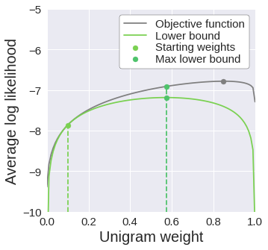
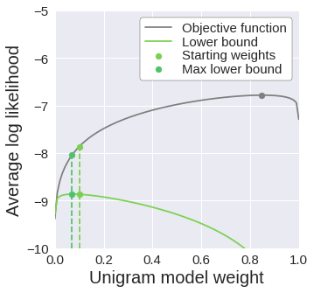

Tight lower bound
A = A'
A' < B' A < B
B' < B
Loose lower bound
A ≠ A'
A' < B' A > B
B' < B
B
A
B'
A
B
A'
B'
A'

Slide 31

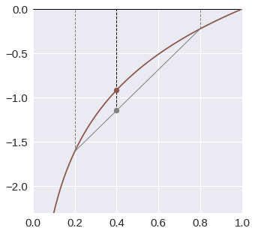
Given:
Jensen's inequality:
function of weighted combination
weighted combination of function

Slide 32
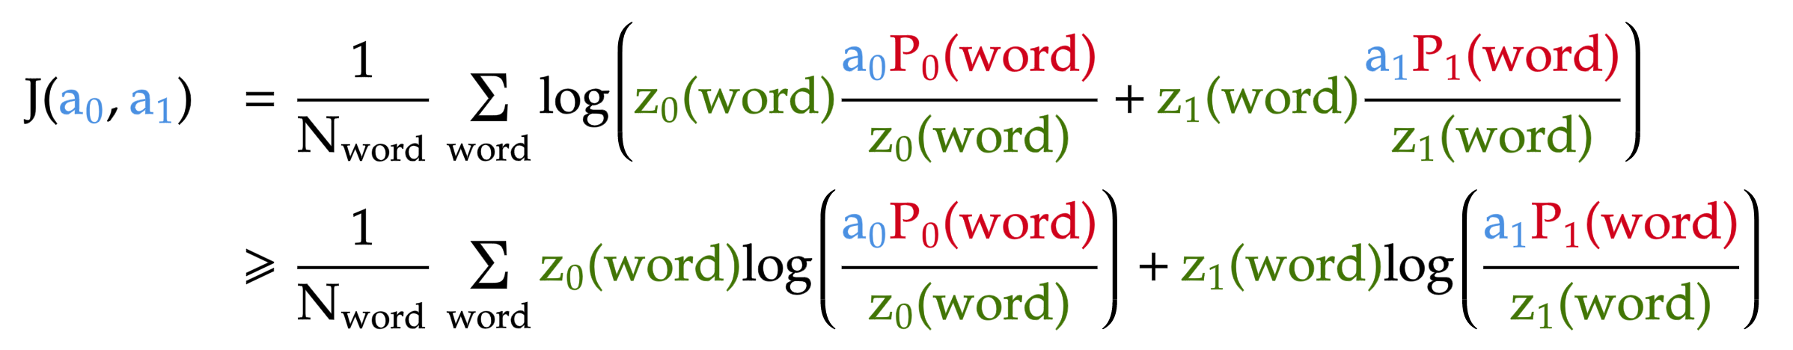
function of weighted combination
weighted combination of function
lower bound of objective function

Slide 33
weighted combination of two logarithms

Slide 34
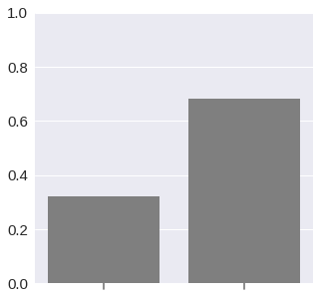
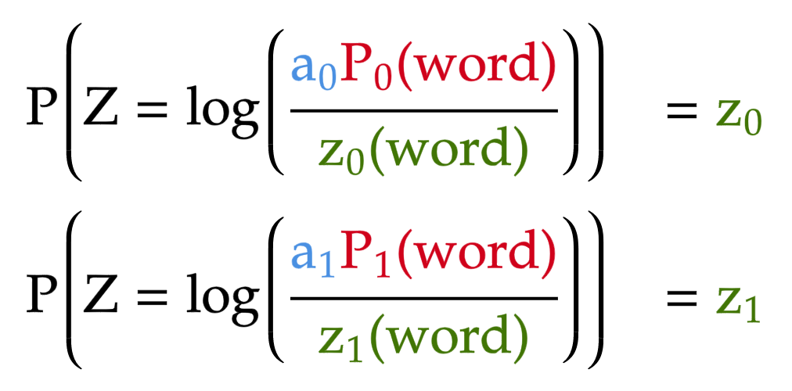
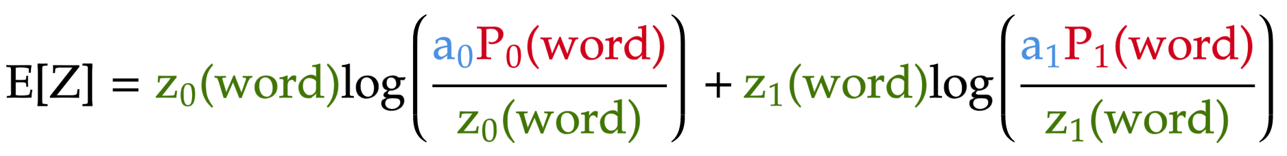
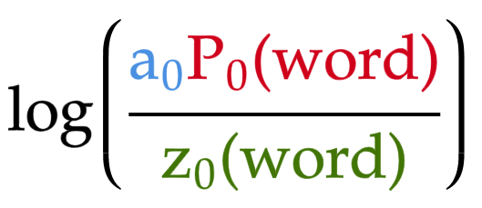
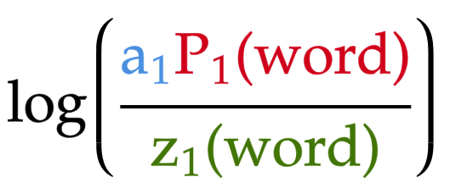
Distribution of Z
Probability
Expectation of Z
Value

Slide 35
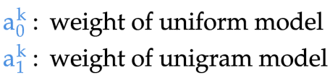
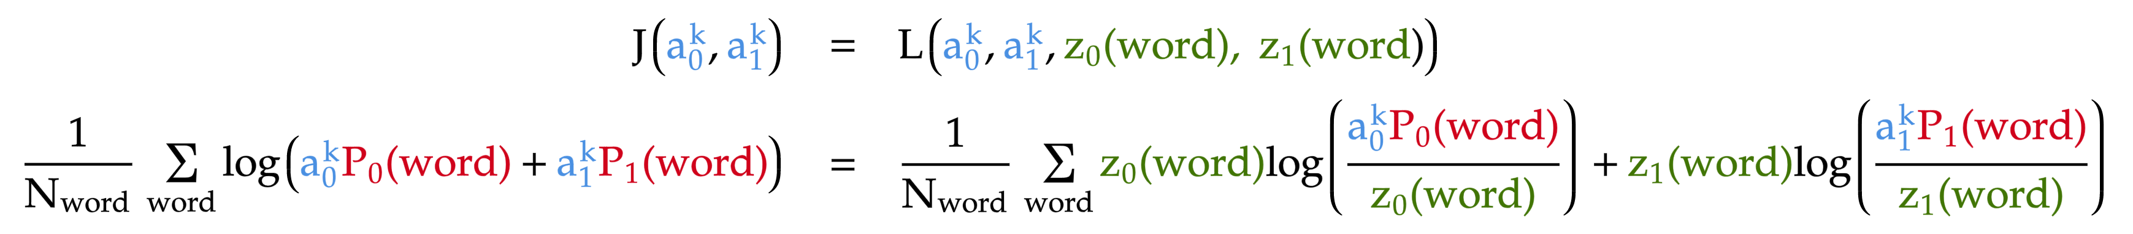
At iteration k
LHS
Objective function
RHS
Lower bound

Slide 36
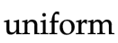

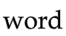
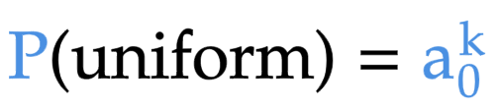
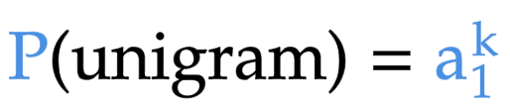




prior
likelihood
Posterior probabilities

Slide 37



Slide 38

lower bound of objective function

Slide 39


Posterior probabilities

Slide 40

Comments

Slide 41


E-step
Calculate posterior probabilities from current model weights
M-step
Update model weights using posterior probabilities from E-step

Slide 42



Updated weights after EM iteration
①
②

Slide 43



①
②

Slide 44


First derivative
Second derivative

Slide 45



dev1

Slide 46



Slide 47



